Slide 1
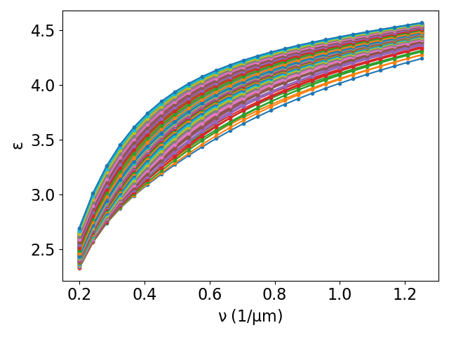
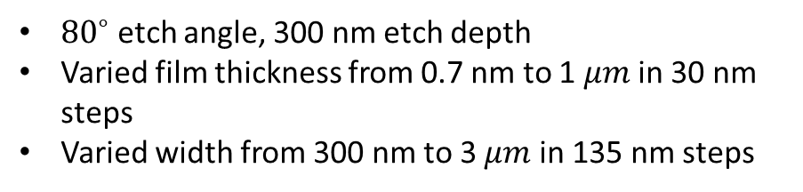
MEEP Mode Solver (MPB) for waveguide dispersion calculation
${80}^{∘}$ etch angle, 300 nm etch depth
Varied film thickness from 0.7 nm to 1 $μm$ in 30 nm steps
Varied width from 300 nm to 3 $μm$ in 135 nm steps

Slide 2
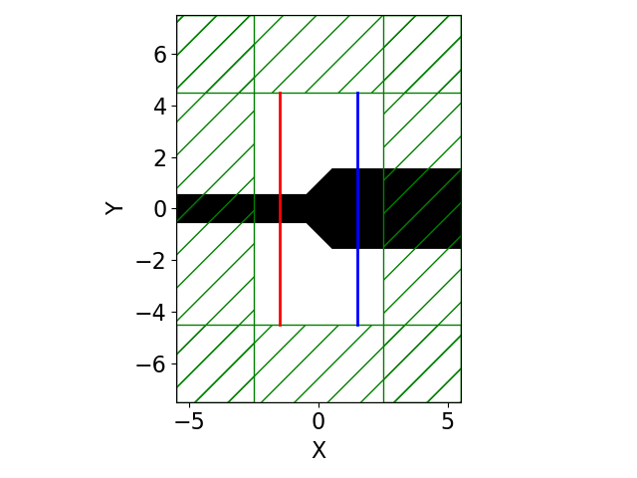
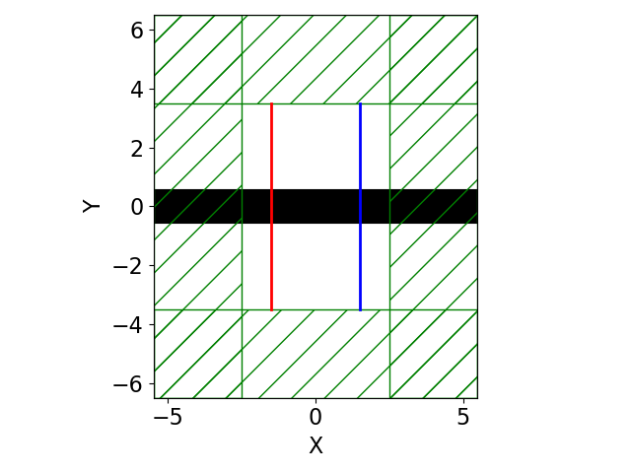
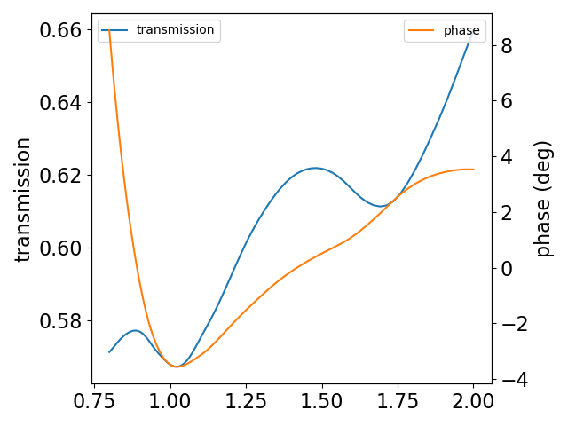
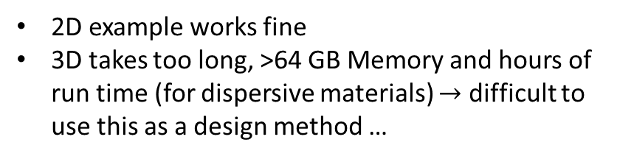
FDTD solver for taper transmission coefficient
2D example works fine
3D takes too long, >64 GB Memory and hours of run time (for dispersive materials) $→$ difficult to use this as a design method …

